Slide 1

Anthony Bourdain’s Travels
Data Deviants
Project 3, Group 2
Van Eisele
Carlos De La Rosa
Abagail Chambers

Slide 2
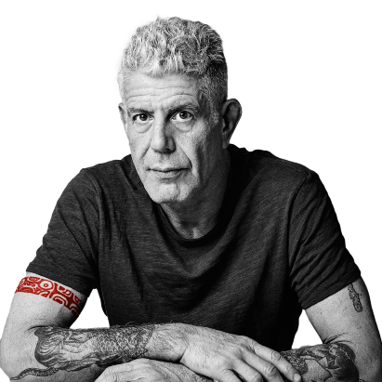
Introduction
Inspiration
We all love food, and we all love Anthony Bourdain, so it was not a difficult decision to delve into his travels for this project.
Dataset
https://www.kaggle.com/datasets/michaelbryantds/anthony-bourdain-episode-locations?resource=download

Slide 3
About the Shows
A Cook’s Tour (2002-2003)
Anthony Bourdain’s first show.
Two seasons.
Anthony was very willing to be bold and experimental in his experiences with not only the foods he tried, but also the people and cultures.
No Reservations (2005-2012)
Anthony Bourdain’s longest running show.
Very similar to A Cook’s Tour in premise, but with improved production quality, and popular guests.
This was the show where Anthony charmed the world with his whit, tastefully executed swearing and bold honesty about everything, including his own and the choices he made living it, both good and bad.
The Layover (2011-2013)
Named for exactly what it sounds like, Anthony Bourdain’s again filled this in-between travel time with food.
A more practical twist on his previous food shows and featured a lot of places near large airports.
Less emphasis on culture and teaching, but the information he was sharing was useful in a more practical way and not as philosophical.
Parts Unknown (2013-2018)
A return to the original idea of merging food and culture and presenting it in an entertaining way.
Anthony really went to the far reaches of the planet, like Antarctica!
Sadly, this would be his last show and another wild success to add to his long and illustrious career.

Slide 4
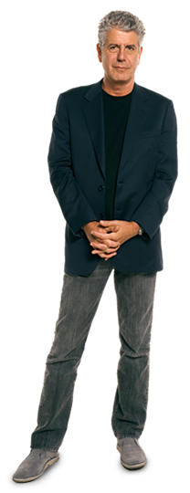


Design Inspiration
Color Scheme
Our aim was a mostly earthy palette, with pops of bold color for emphasis.
Some examples of our colors:
Image Inspiration

Slide 5
Data Engineering
Data Cleaning
Our open-source dataset download provided two CSV files, though our group realized early on that only one of those was useful for our purposes, the other being a truncated and reformatted version of the same data. Once we read in our primary CSV, we found the data itself to be relatively clean. We dropped a total of four columns as unnecessary, only needed to convert a single column’s data format, and renamed only a single column header.
Distance Calculation
Great-Circle Distance vs. Euclidean Distance
In our mapping efforts, it came to our attention that our initial distance calculations were based on straight-line distances, otherwise known as the Euclidean space between two points. Correcting this required mathematical conversion to great-circle distance, which is still the distance between points, but measured along the surface of a sphere. Using this conversion was a slower method but produced more accurate results.

Slide 6

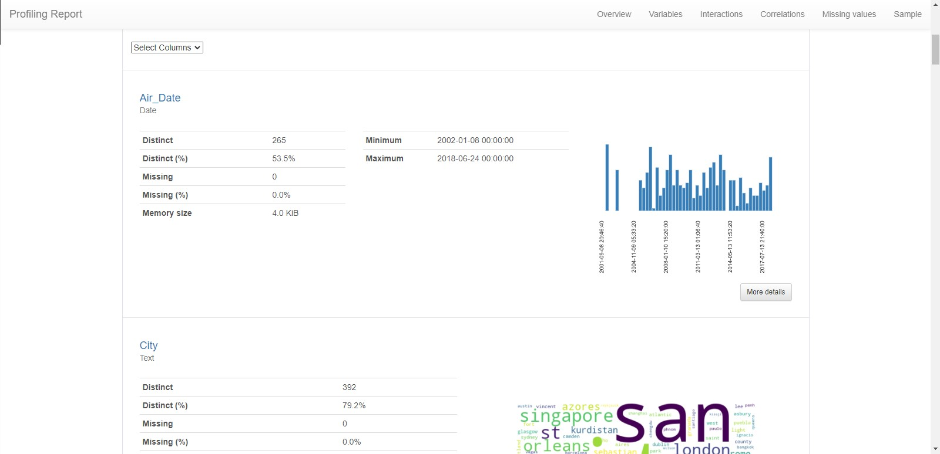
ydata_profiling, aka df_profile The Data Deviants have the immensely helpful Sherhone Grant to thank for pointing them in the direction of an EDA golden ticket, otherwise known as the ydata-profiling package for Pandas. With a quick pip install, and just a few lines of code, our data was instantly analyzed and visualized in a completely interactive way before our very eyes!

Slide 7



Research Questions and App Demo

Slide 8
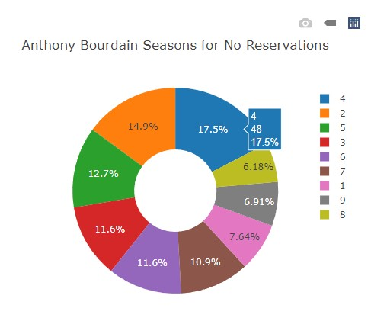

What was Anthony Bourdain’s top show? ‘No Reservations’ aired a total of 275 episodes over the course of 2,660 days, which is just over 7 years. ‘Parts Unknown’ aired 158 episodes over 1,897 days, or just over 5 years. ‘A Cook’s Tour’ aired 42 episodes over 454, or just over 1 year. ‘The Layover’ aired only 20 episodes over 441 days, also just over 1 year.

Slide 9
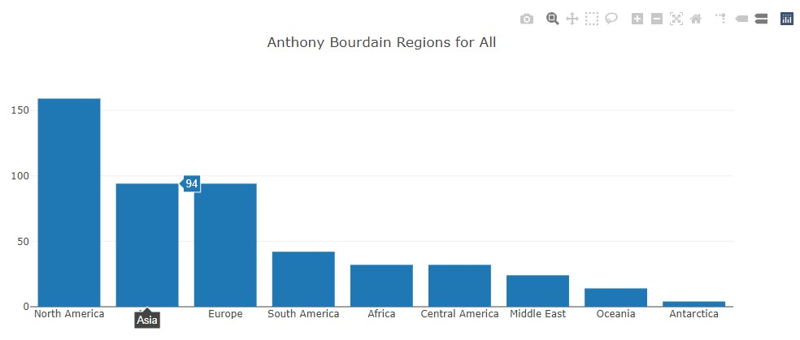
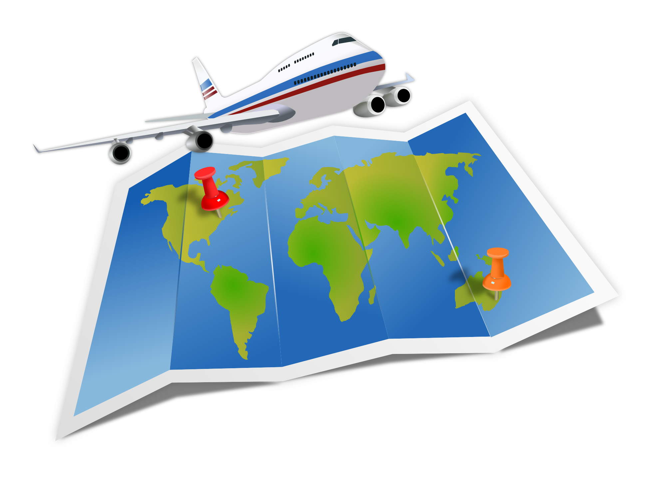
Do we see any trends in the areas or countries of his travels? Anthony Bourdain’s most frequently traveled region across the globe, across all his shows, was North America, with a grand total of 159 episodes. Second place varies between shows as either Europe or Asia, but cumulatively between all his shows, they even out at 94 episodes each. His least frequently visited region of the world was Antarctica, with just 4 episodes, all exclusive to the show ‘Parts Unknown’.
This Photo by Unknown Author is licensed under CC BY-NC

Slide 10
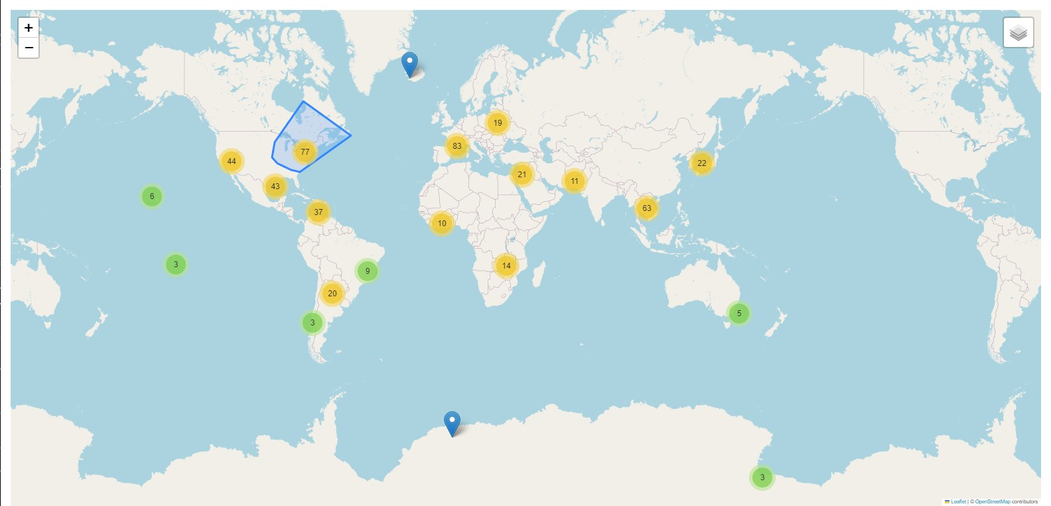
Map Circle colors indicate density of individual points, with the actual number shown in each circle. Clicking any given circle auto-zooms the map, and progressively separates map points. Then click individual map points for specific show and location information.

Slide 11
Conclusions:
“Travel is fatal to prejudice, bigotry, and narrow-mindedness.” – Mark Twain.
Anthony Bourdain spent over a decade of his life traveling the globe; eating, drinking and experiencing other regions, countries, and cultures, so that his viewers could be exposed to information they might not otherwise be privy to. It may be enough for some to simply revel in the information itself, while others may be motivated to follow parts of his path, or even be inspired to mind some of his tips and suggestions, either locally, should one be so lucky, or in the form of travel plans near or far.
Limitations: We would have really liked to have been able to use food data. Unfortunately, our dataset did not include any specific dish references. The only place our team was able to find such information would have required a great deal of web scraping, which would have taken more time than we had to complete this project. Also, in terms of the travel distances, our calculations represent a cumulative path between unique locations; whereas, in reality, he could have traveled back to his home city of New York between some, or all, of his trips, amassing a great deal more overall miles traveled.
Future Work: It would be really interesting to acquire food data for all his various travels, and to be able to include that data in our mapping. We could also try to hunt down additional data about his actual travel paths to produce more accurate mileage calculations.

Slide 12

Thank you & Happy Travels!

